Slide 1
BuildNC: Fighting for a Good Roads State

Slide 2
Situation Analysis
Special interest groups are often able to delay approved road projects through legal maneuvering. These groups tend to dominate the public conversation through the media and public events. Unfortunately, the negative impact of these delays for the taxpayers is often ignored or under reported.
On top of the immediate problem of removing roadblocks to progress, we also join so many others in recognizing the need for long-term transportation funding reform.

Slide 3
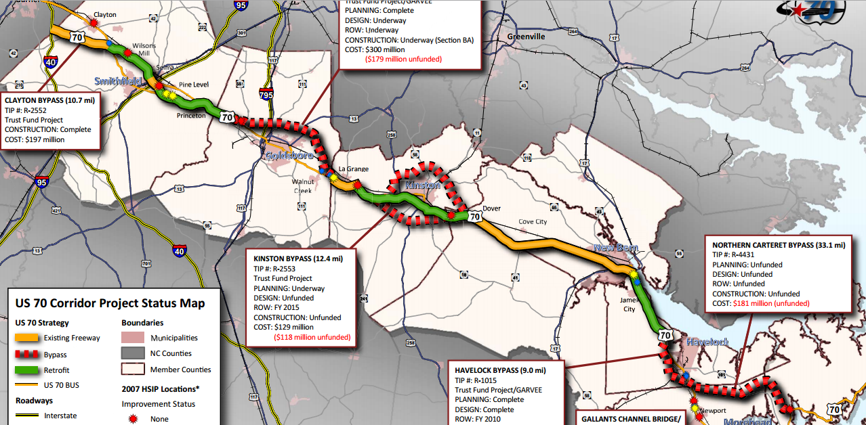
Our Challenge
Notes:
Major transportation projects in North Carolina are under serious legal challenges. This persistent barrier to progress is causing serious problems for the Department of Transportation, local governments and taxpayers.

Slide 4
Our Mission
To ensure that North Carolina gets the most economic benefit from roads by providing a voice for local transportation projects and developing solutions to get more funding for transportation.

Slide 5
Approach and Strategy
Aggressively own the issue
Communicate consistently
Influence the policy makers through government affairs and grassroots
Build a broad base of support

Slide 6
What can we do now?
2014
Establish Legislative Goals
Present a consistent, positive voice for media
Reinforce local efforts and build a statewide coalition

Slide 7
Team
Christopher Hollis
Christopher will act as government affairs director and fundraiser.
Greer Beaty
Greer will coordinate messaging, media training of advocates and serve as spokesperson
Andrew Meehan
Andrew will coordinate advocacy outreach, including paid media production and grassroots management

Slide 8
Join BuildNC
BuildNC
321 Briarhaven Court
Garner, North Carolina 27529
chris@cshollis.com

