Slide 1
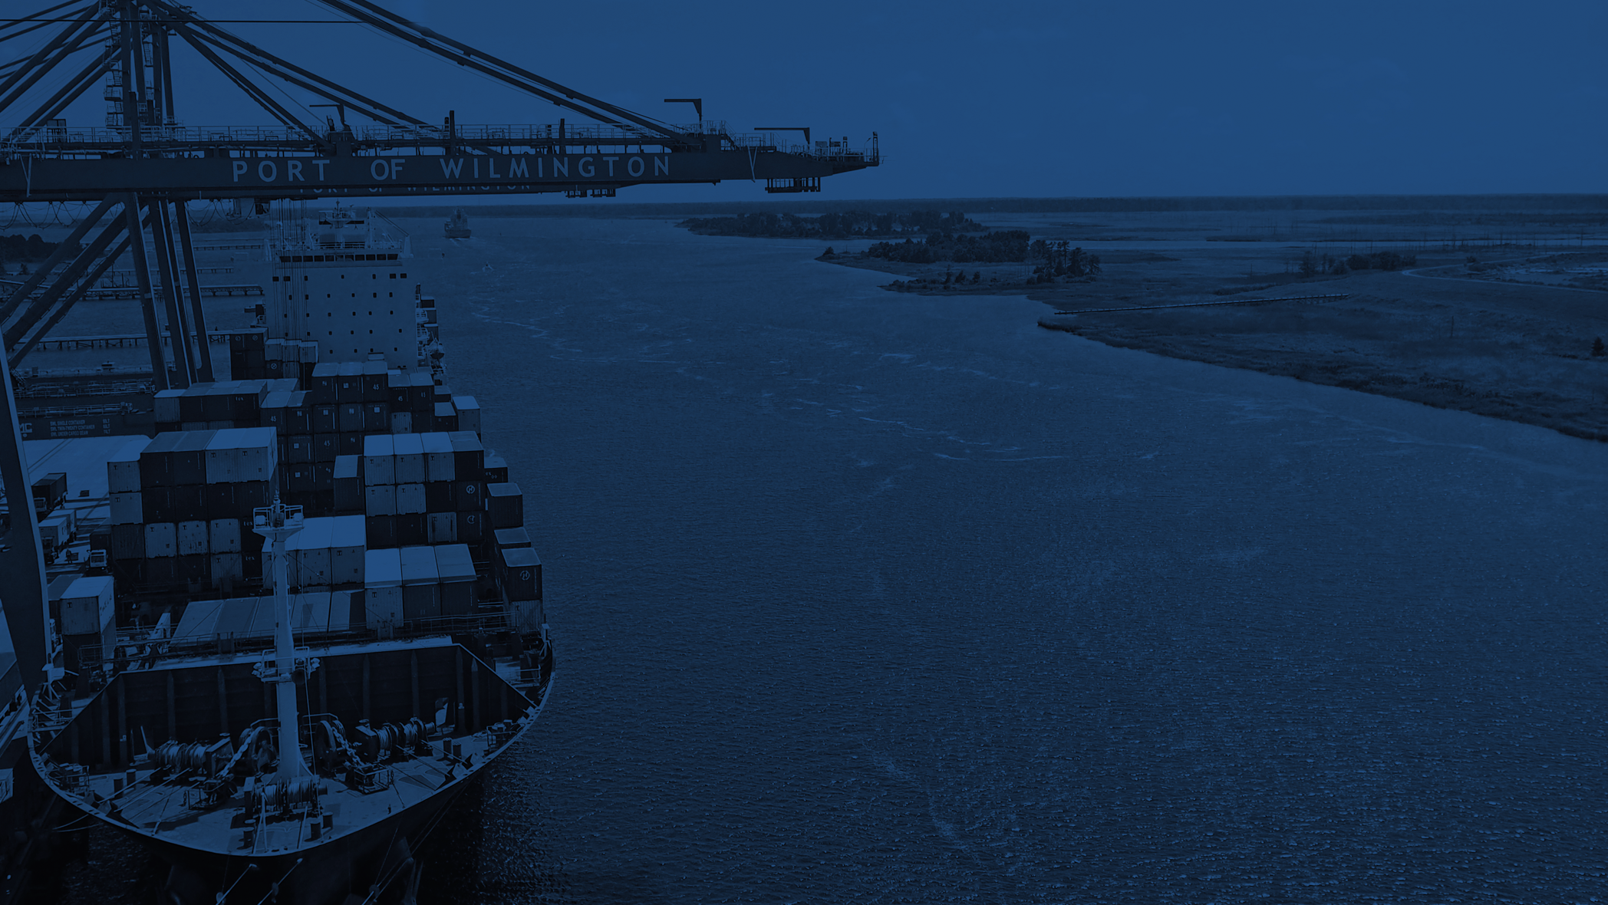
As we get bigger,
the world gets smaller.

Slide 2
Agenda
Current Status of Performance
Market/Carrier Update
Projects in Motion
Infrastructure Investment
Intermodal Rail Capability
Summary

Slide 3
Current Status of Performance

Slide 4
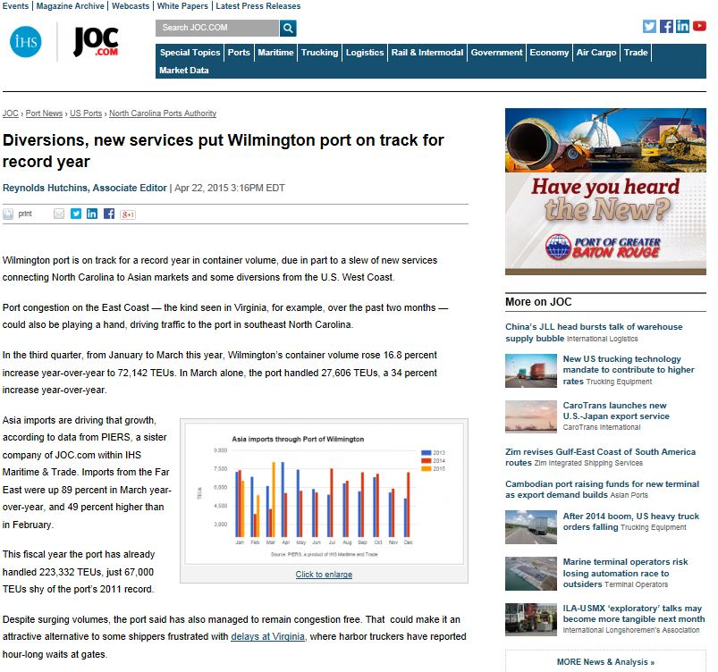
Banner Year in FY 2015
Broke Authority record in terms of number of containers handled (just under 300,000 TEU, 18% increase year-over-year)
One of the fastest growing ports on the U.S. East Coast by container volume growth percentage
New services, diversions, and lack of congestion have led to banner year
Most profitable year in Authority history

Slide 5
Current Status of Performance
Profit Driven
2016 Full Year Estimate– $1.7M
  Year to date
  Revenue : $22M through December (same as prior year)
  Net income : $2.2M FY16 ($2.4M prior year)
  Volume: Exports are decreasing due to affects of global economy – strong dollar
    Containers: -3% vs. prior year
    General Cargo: 10% over prior year
  Asset Sale: Southport Marina

Slide 6
Market/Carrier Update

Slide 7
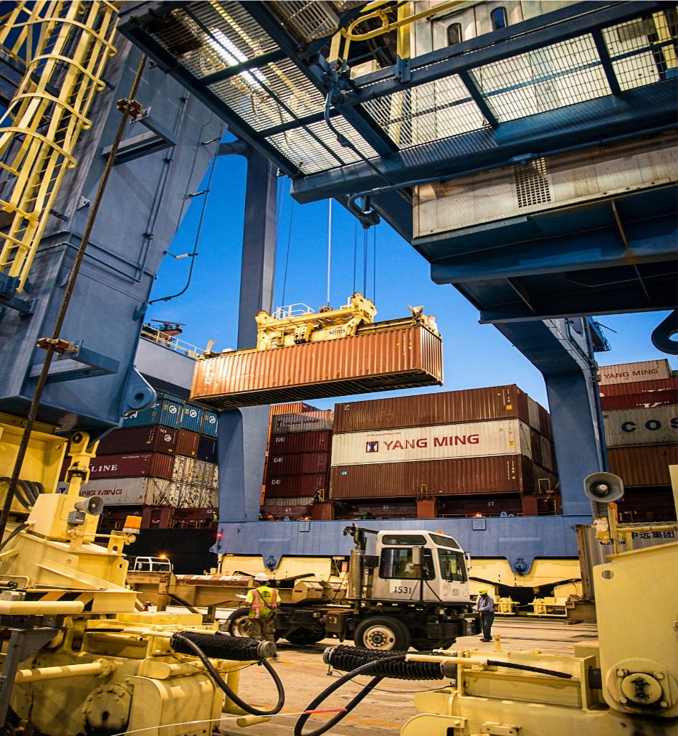
Business Development Efforts
Increasing focus on marketing/sales
  New Chief Commercial Officer
  Coverage of cargo owners/shipping companies
  Get the word out
Container segment a priority
  Industry consolidation
  Panama Canal Expansion
  Increase vessel service options for N.C. community

Slide 8
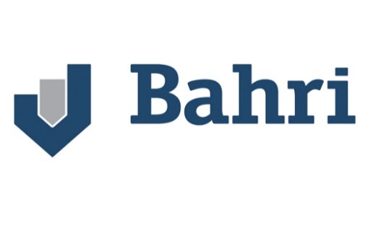
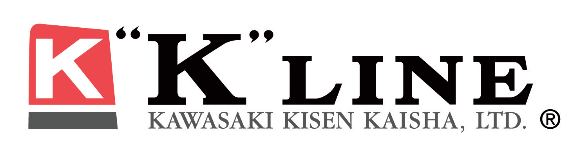

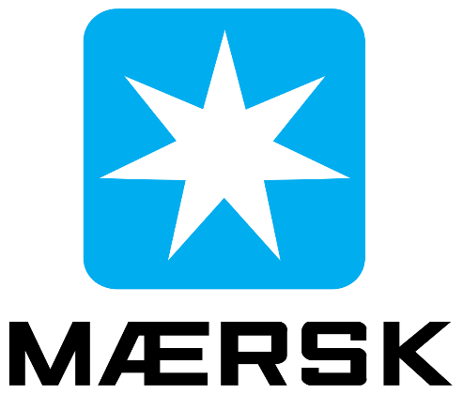
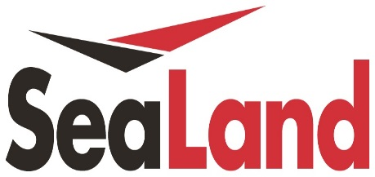
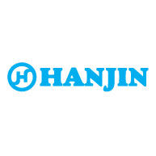
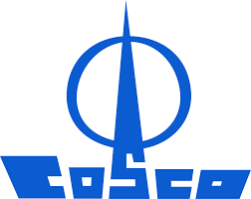
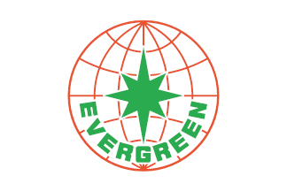


Port of Wilmington Ocean Carriers
New Service
In discussions

Slide 9
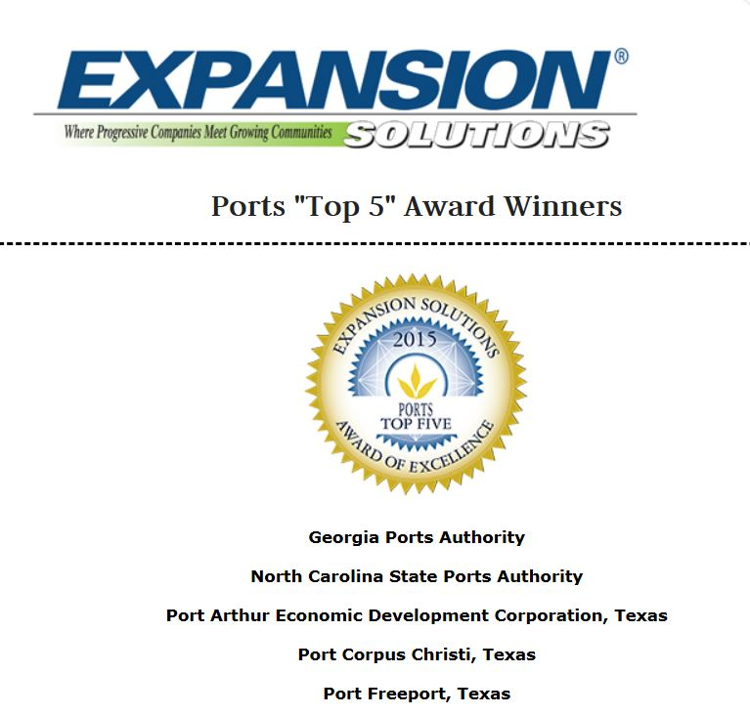
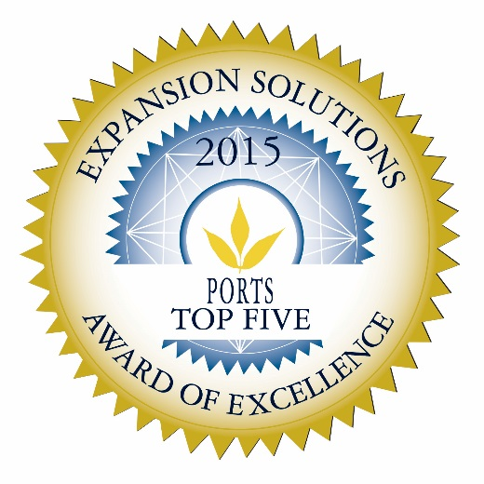
Industry Leader in Customer Satisfaction
Expansion Solutions Magazine recognizes N.C. Ports in its 9th annual “Top Five” Awards of Excellence
These awards identify economic development organizations which have shown exceptional progress and potential in the area of recruiting, retaining and growing businesses

Slide 10
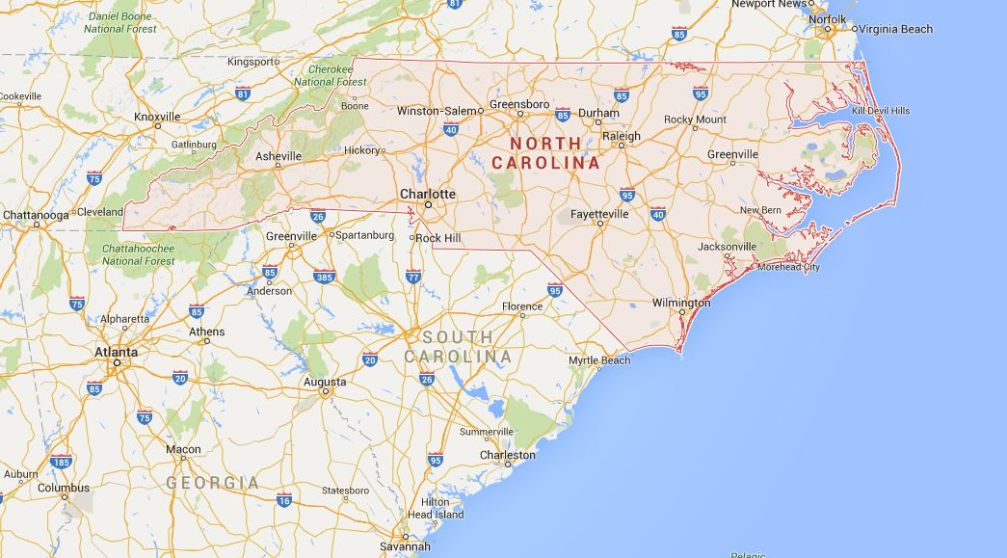
Opportunity to Improve Supply Chain
Norfolk
27%
18%
43%
Wilmington
Charleston
Savannah

Slide 11
Projects in Motion

Slide 12
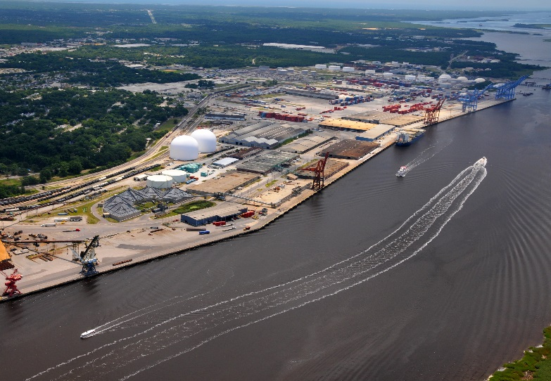
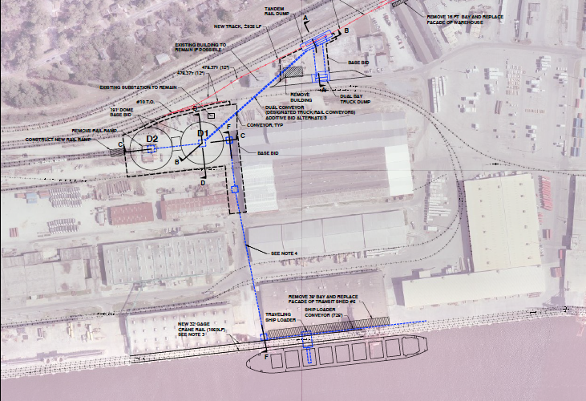
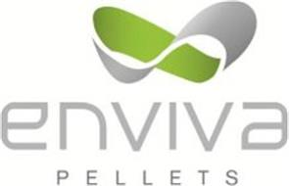
Port of Wilmington Export Pellet Facility
Long-term lease on port property
Design, finance, build facilities, $35M investment
Commence exports in 2016
Forecast 1M+ tons per year
Production facilities in Sampson County
and Richmond County

Slide 13

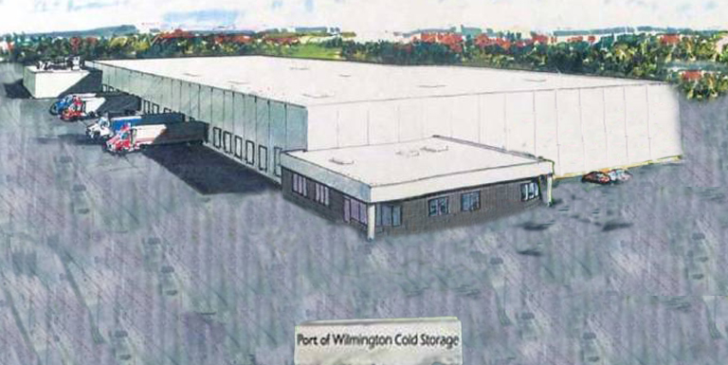
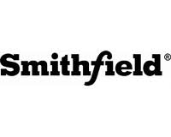

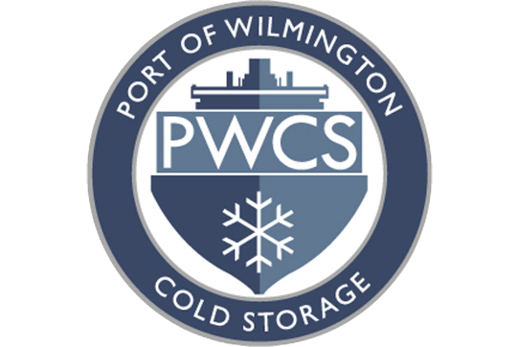

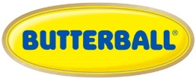
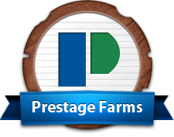
North Carolina is Home to Protein
Construction Underway
101,537 square feet of initial construction
200,000 square feet of expansion space planned
NC Agriculture ranks nationally:
#1 sweet potatoes
#2 pork and turkey production
#5 poultry production

Slide 14
Infrastructure Investment

Slide 15
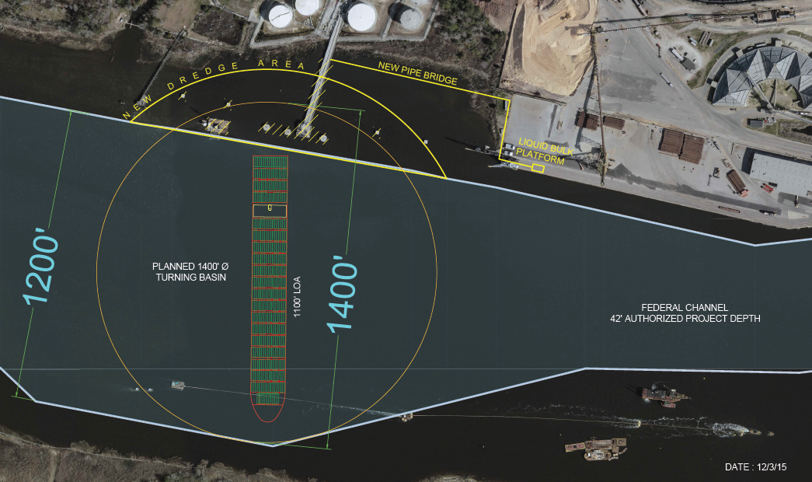
Turning Basin Expansion Project
All major regulatory permits obtained
Construction bid awarded – Burgess Corp. (Jacksonville, NC)
Panama Canal opening allows completion date to June 30, 2016

Slide 16
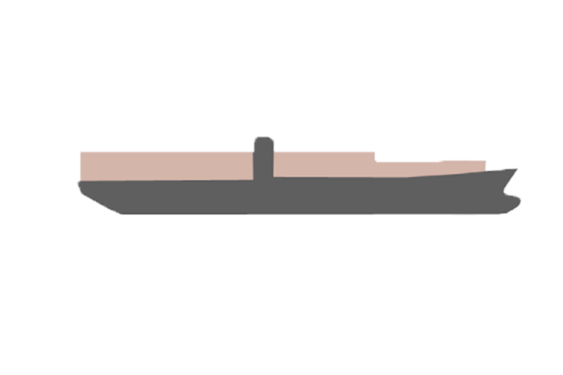
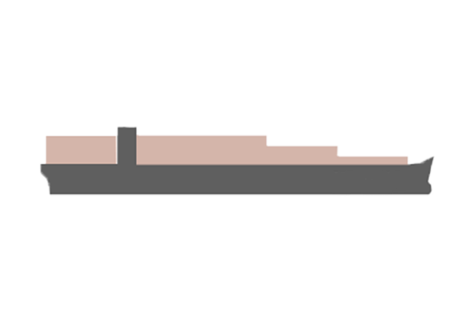
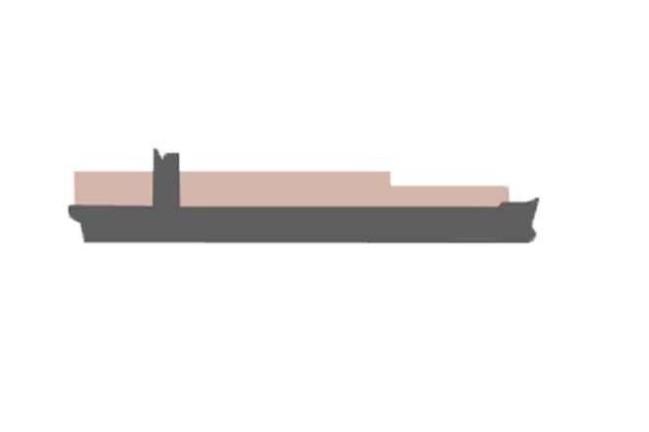
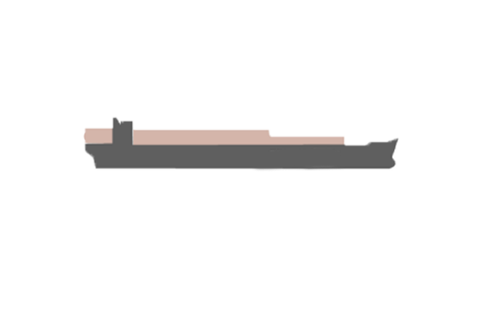
Container Shipping Specifications
10,001-12,500 TEU
Length: 1,200+ ft (366+ m)
Beam: 161-170 ft (49-52 m)
Designed Draft: 45-50 ft (13-15 m)
10,001-12,500 TEU
8,001-10,000 TEU
Length: 984-1,100 ft (300-335 m)
Beam: 158-161 ft (48-49 m)
Designed Draft: 41-48 ft (12-14m)
4,501-8,000 TEU
Length: 965-984 ft (294-300 m)
Beam: 141 ft (43 m)
Designed Draft: 41-45 ft (12 -14 m)
Length: 951-965 ft (290-294 m)
Beam: 105 ft (32 m)
Designed Draft: 41 ft (12.5 m)
3,400-4,500 TEU
* Most vessels that arrive at the Port of Wilmington do not arrive at designed draft

Slide 17
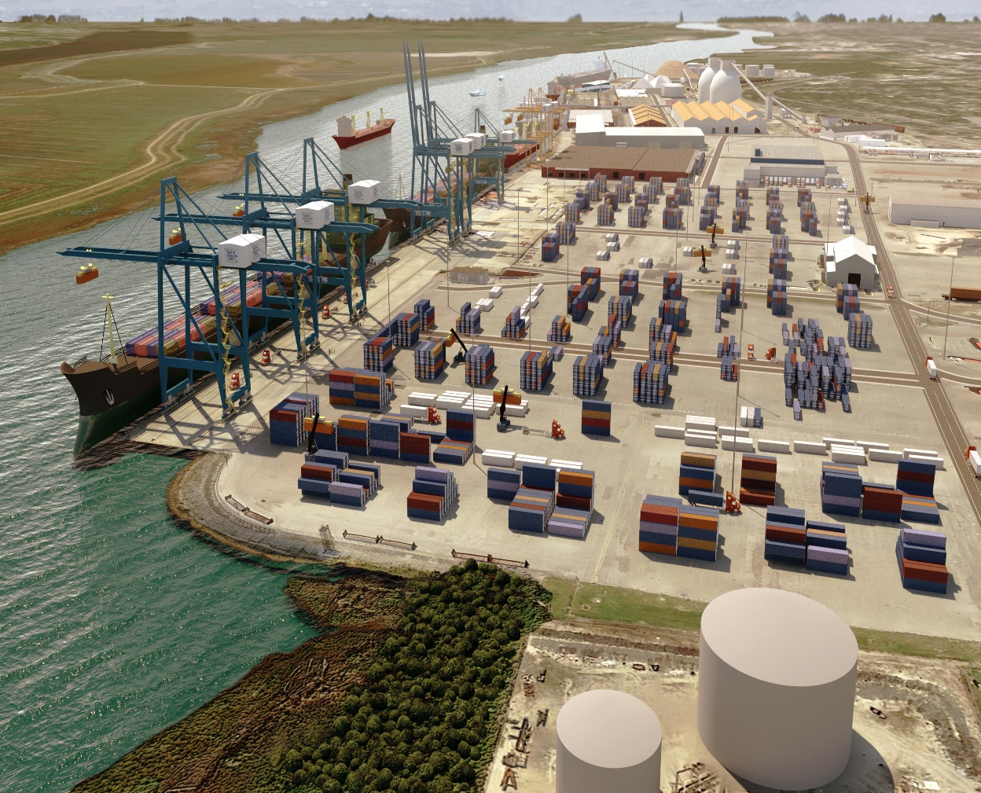
Port of Wilmington
Infrastructure Investments
Berth 8 replacement project
Purchase new post-Panamax container cranes
Capability to operate two post-Panamax vessels simultaneously
Estimated completion December 2017

Slide 18
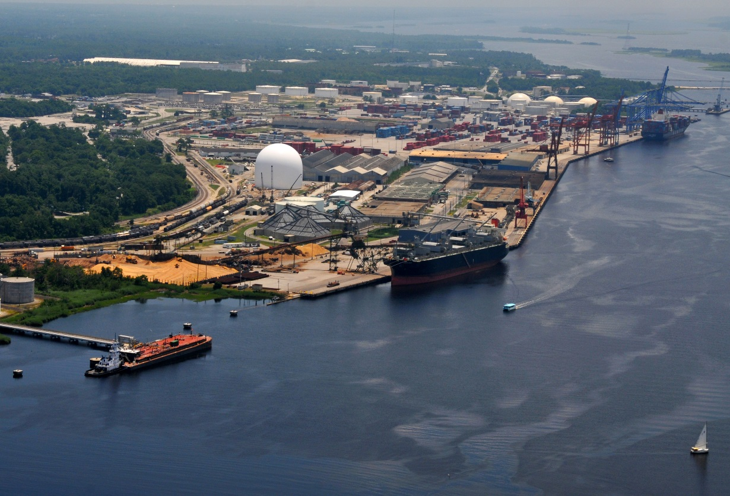
Cape Fear River Channel
Study underway with U.S. Army Corps of Engineers to complete navigational improvements to the channel, including deepening the Cape Fear River basin
Long-term viability requires channel improvements
Neighboring ports well underway

Slide 19
Infrastructure Investment
Berth 8 Replacement & Related Upgrades ($53 - $58 million)
Replace 645 ft x 200ft of dock structure
Includes 645 ft of new landside crane rail
272 ft extension of 50 ft gauge rail
Rail extension to Berth 6 with partial removal of T-7
Structural improvements to waterside crane rail on Berths 7 and 9
Post-Panamax Container Cranes ($32 - $36 million)
Turning Basin Expansion ($10 - $12 million)
Relocate liquid bulk pier and dredging at east side of turning basin
Morehead City Dredging ($3.1 -$3.5 million)
NCSPA funding current year’s inner harbor dredging
Wilmington Harbor Study ($1.4 million)

Slide 20
Intermodal Rail Capability

Slide 21
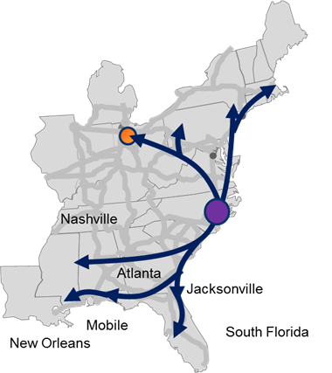
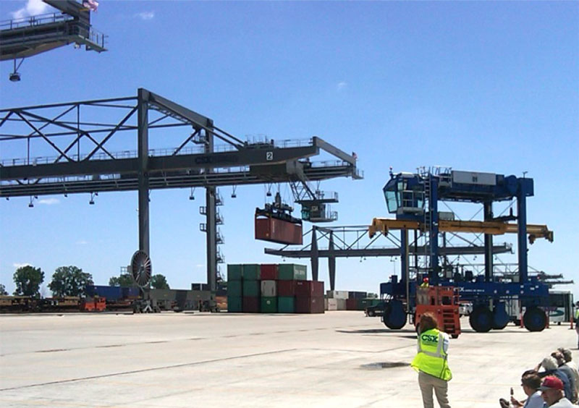
CSX’s Central Carolina Connector (CCX)
CCX will be a transformational, state-of-the-art intermodal rail terminal in Eastern North Carolina which will serve as a major transportation hub in the Southeast

Slide 22

Central Carolina Connector benefits to N.C.
Economic Development Opportunity
A transportation “hub” in the mid-atlantic region
Catalyst for distribution centers, warehouses and logistics consolidators
Manufacturers near CCX – competitive advantage
Reduce traffic on interstates and highways (I-95/I-85/I-40)
Improves safety and reduces emissions for freight traffic
N.C. Ports Advantages – Intermodal
Direct rail to Charlotte
Direct access to CCX hub – premiere service over southeast ports
Recent N.C. Ports Customer Survey –
90% want intermodal service

Slide 23
Summary

Slide 24
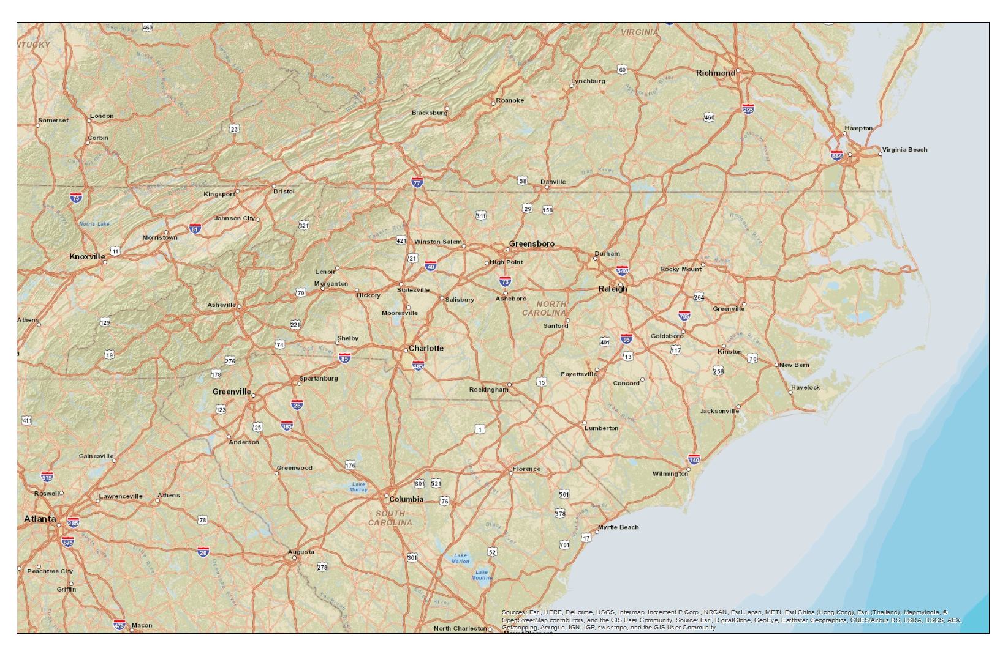
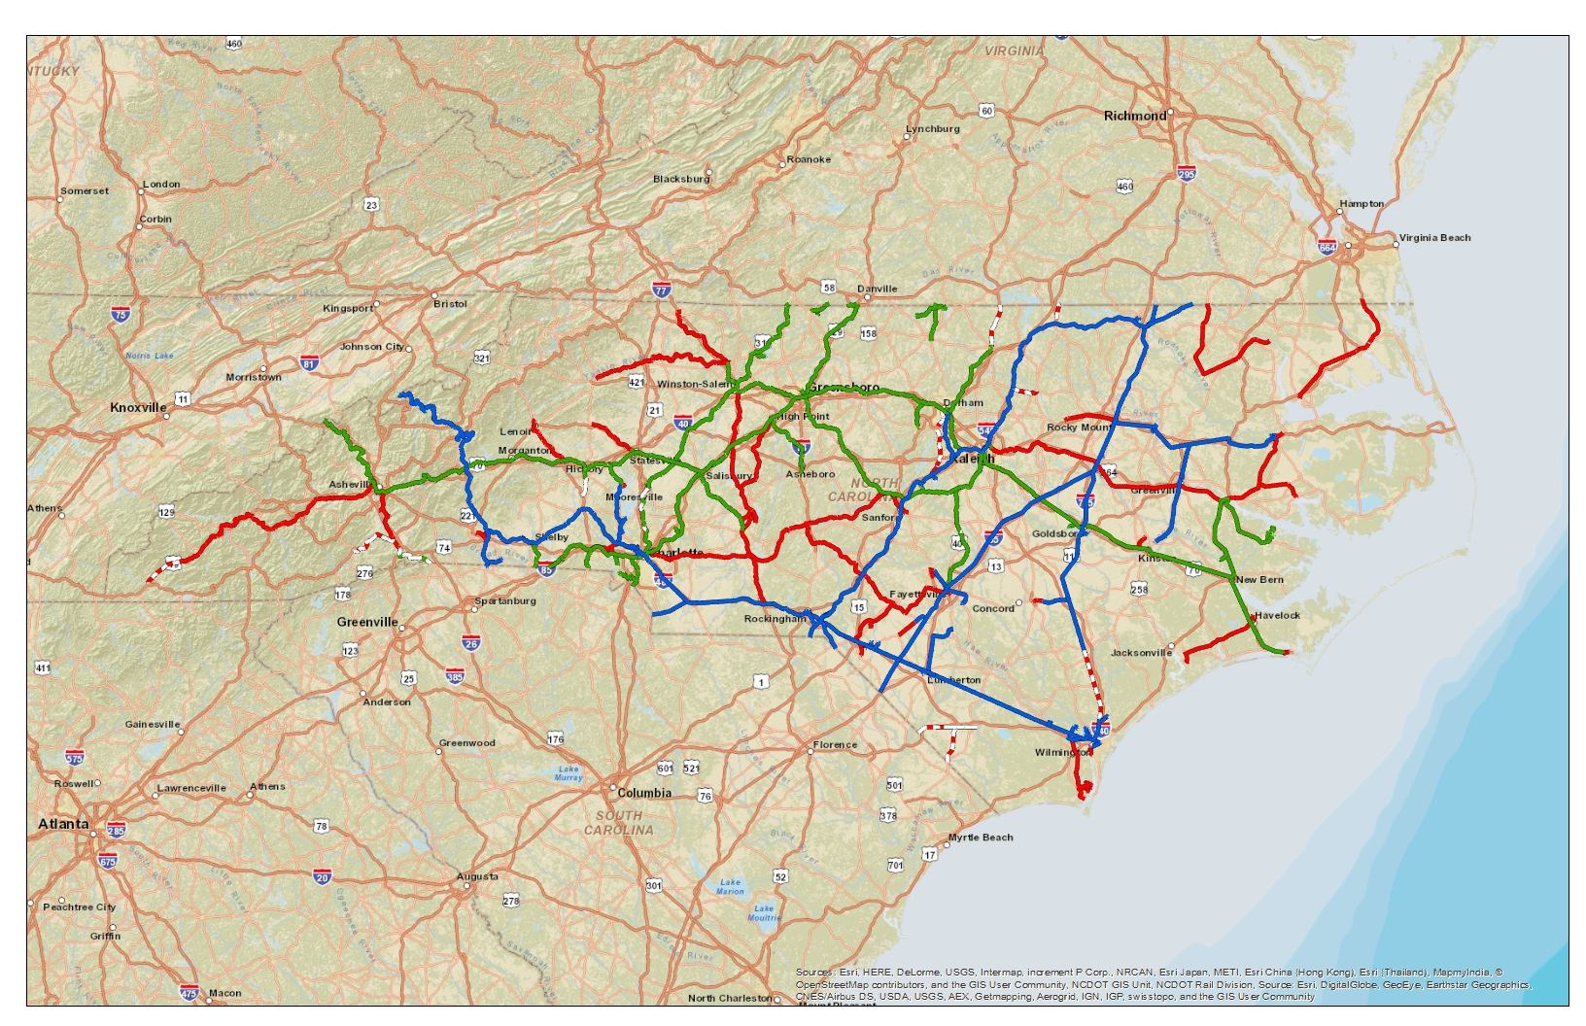
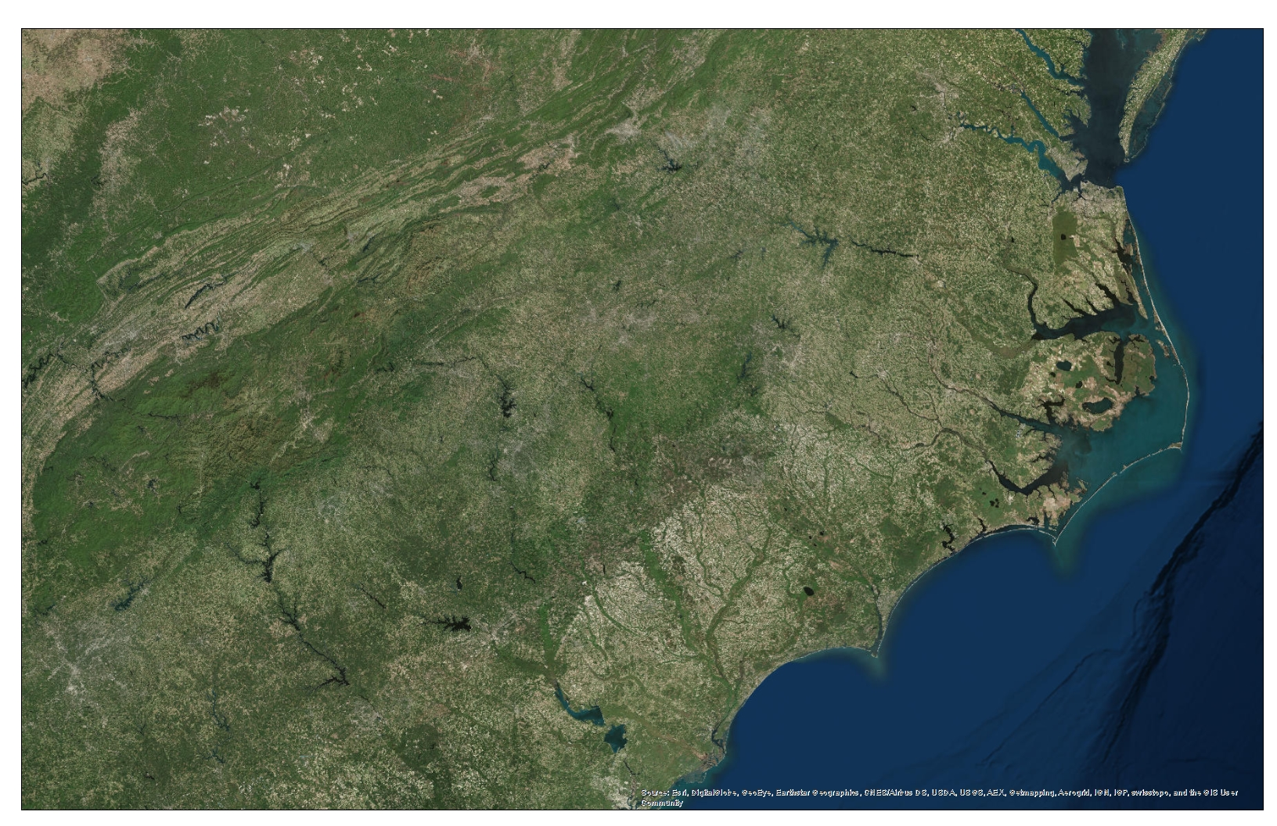

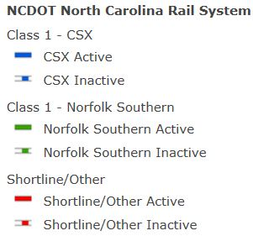
Part of an Integrated Transportation Network
Port of Morehead City
Port of Wilmington

Slide 25
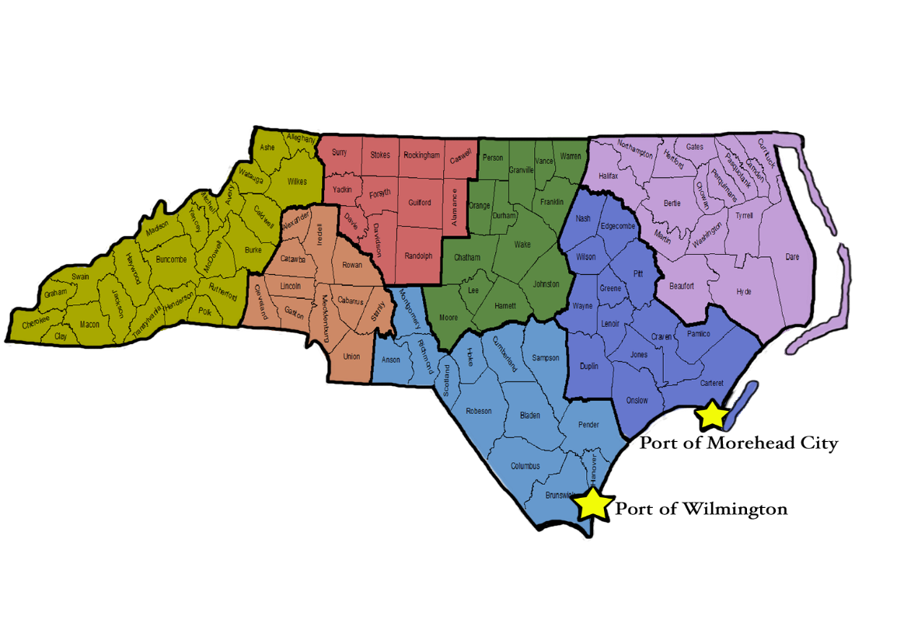
Ports Support N.C.
13,700+ jobs
2,200+ jobs
1,700+ jobs
10,400+ jobs
12,500+ jobs
9,800+ jobs
26,200+ jobs
North Carolina jobs provided directly or indirectly by the ports statewide
76,700 +
Annual tax revenues gained through the ports for the statewide economy
$707 million +
Annual economic contribution to the state’s economy associated with goods moving through N.C. Ports
$14 billion +
Economic Contribution of the North Carolina Ports
Institute for Transportation Research and Education, N.C. State University

Slide 26
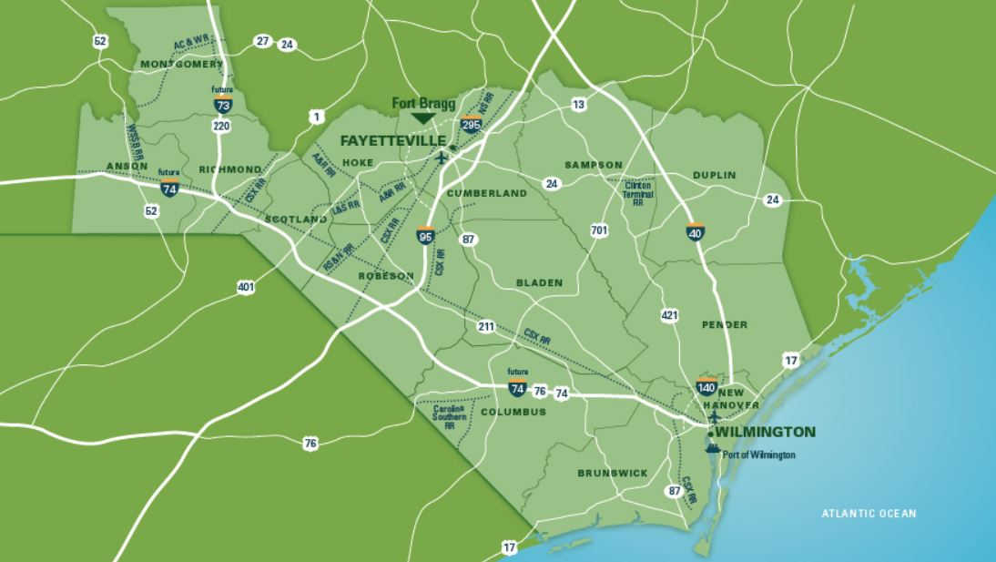
Industrial Site Development Near the Port of Wilmington
International Logistics Park of North Carolina
18.6 miles from Port of Wilmington, 1,029 acres, shovel ready, direct access to U.S. Hwy 74/76 with fast access to I-40, I-140, I-74 leading to I-95
Mid-Atlantic Industrial Rail Center
18.6 miles from Port of Wilmington, 1,025 acres, shovel ready, direct access to U.S. Hwy 74/76 with fast access to I-40, I-140, I-74 leading to I-95
Pender Commerce Park
13 miles from Port of Wilmington, 431 acres, shovel ready, direct access to U.S. Hwy 421 with fast access to I-40, I-140, I-74 leading to I-95

Slide 27
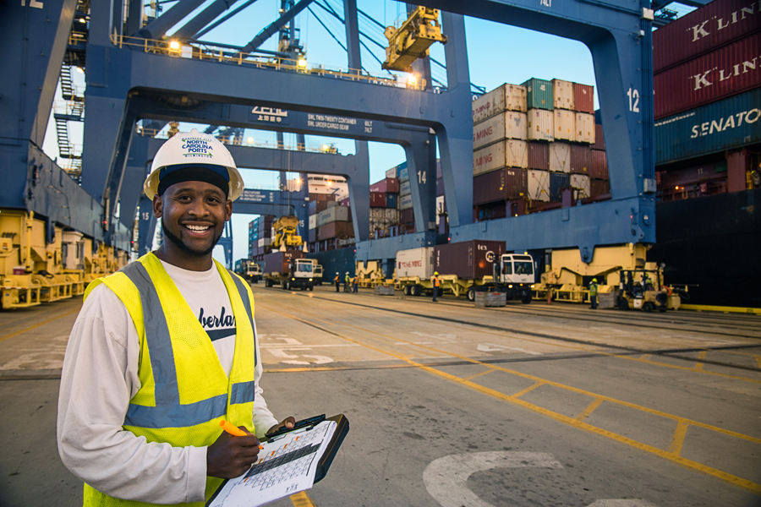
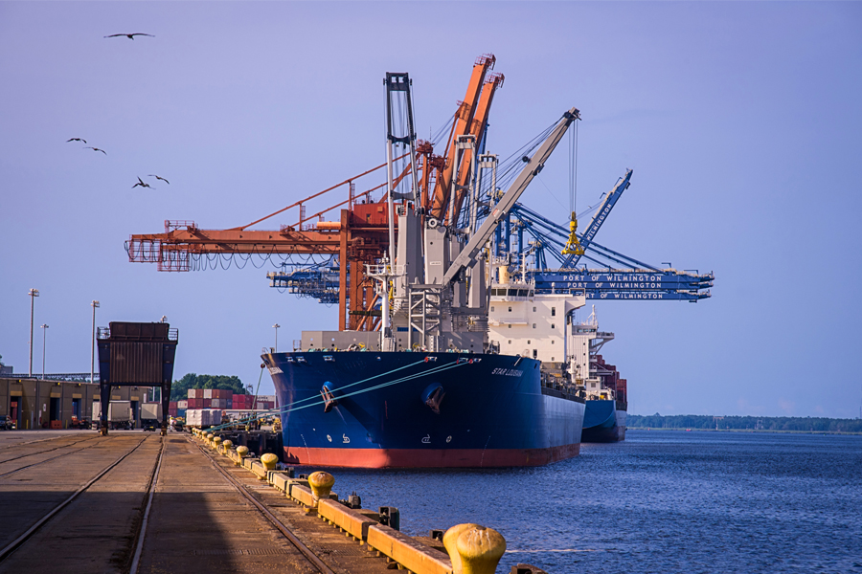
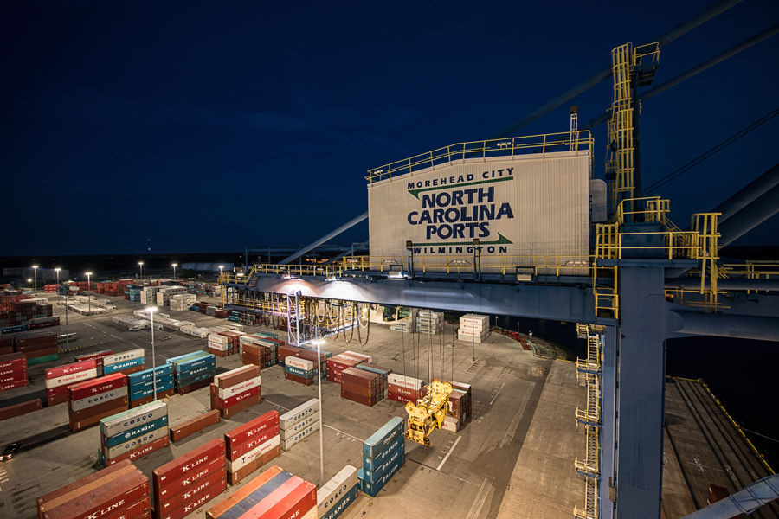
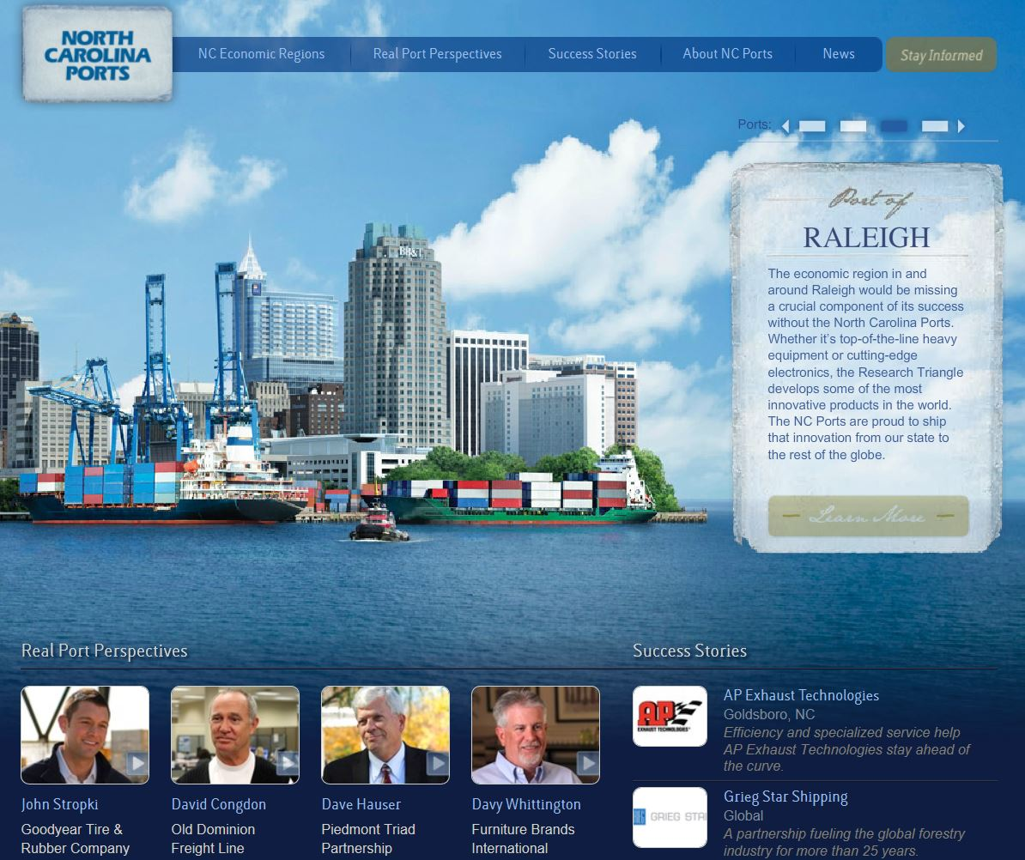
North Carolina Ports Advantages
Unmatched Performance
- One of the highest crane productivity rates in the South Atlantic
- Second to none truck turn times
Velocity Leader
Fast, seamless service from the berth, to the yard, to the gate
Lack of congestion
Cost Efficient
- We offer cost competitive solutions to our customer base
Impeccable Service
- Accolades from customer base

Slide 28
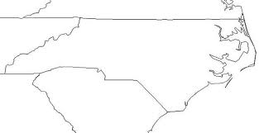





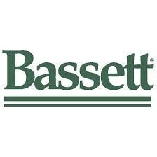






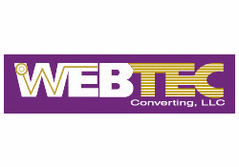
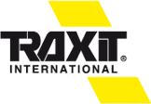

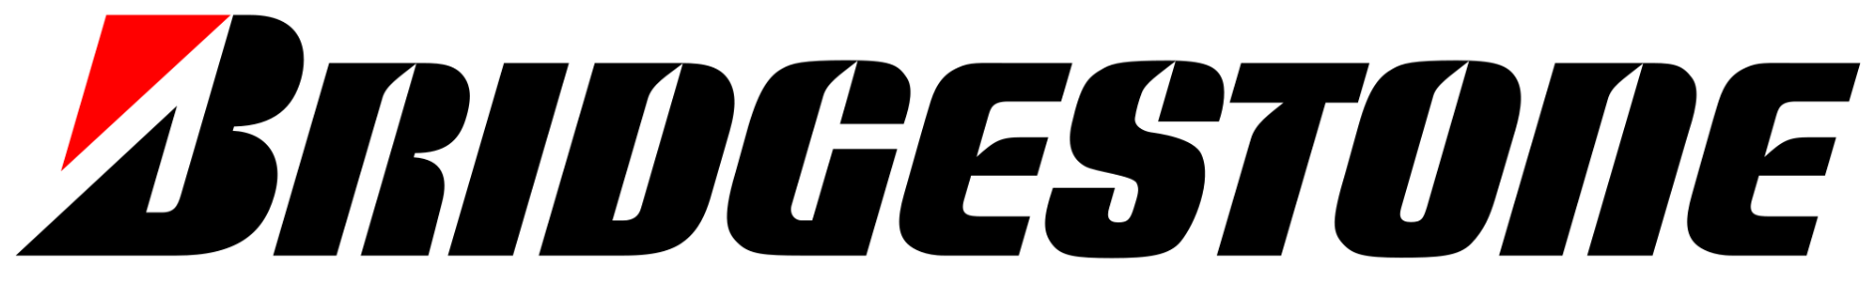


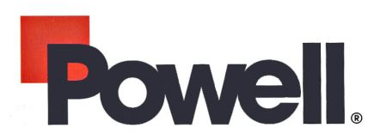




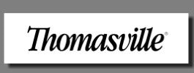

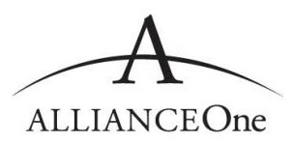
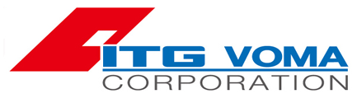


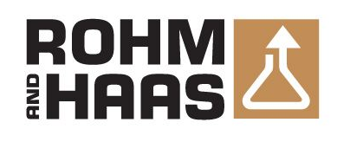




























































































Imagine Your Future Here

