Slide 1
US 70 Corridor Commission
Board of Director’s Meeting
Presented by
John Nelms - Duke Energy Progress ED Manager

Slide 2
Corporate Overview

Slide 3
It’s a new day at Duke Energy
In 2012, Duke Energy and Progress Energy combined forces to become the largest electric utility in the U.S., serving more than 7.2 million customers in six states in the Southeast and Midwest.
But “bigger” has never been Duke Energy's goal. Instead, the company focuses on being the best. The new Duke Energy has the size, scale and financial strength to modernize operations while continuing to hold down costs for its customers.
One of the most important ways we serve our customers is through economic development. Duke Energy is going to great lengths to attract businesses, help create jobs, and strengthen community vitality in the regions it serves. We collaborate with state and local governments to improve industrial sites and recruit new companies to our services territories.
Today, energy is more than just keeping the lights on. We are a highly sophisticated technology company disguised as a 21st century electric utility. Duke Energy is an industry leader in sustainable innovation, providing solutions that help its customers and communities thrive and grow.

Slide 4
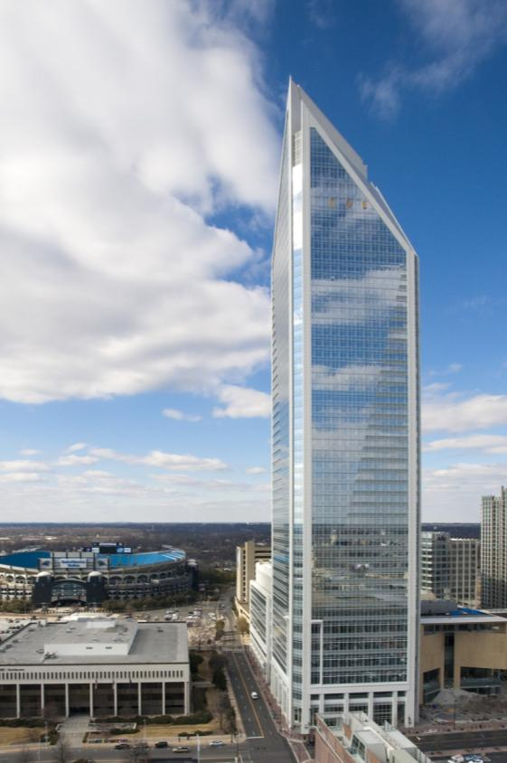
Factoids
150+ years of service
7.2 million electric customers / 500,000 natural gas customers
Fortune 250 company
$110+ billion in assets
Stock dividends for 85+ years
Traded on NYSE as DUK
Dow Jones Sustainability Index
100 Best Corporate Citizens by Corporate Responsibility magazine

Slide 5
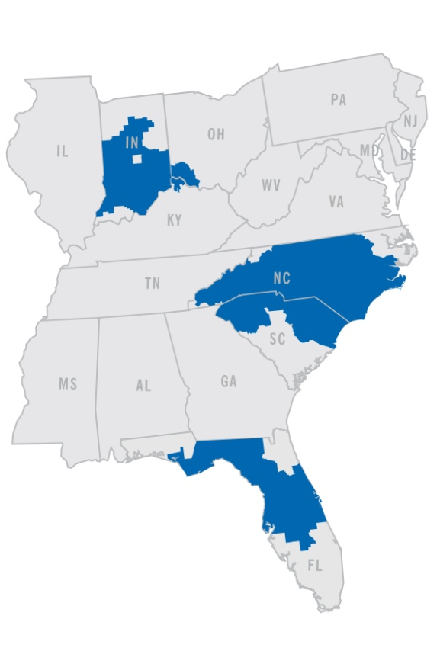
Largest business segment and primary source of earnings growth
6 states: North Carolina, South Carolina, Florida, Indiana, Ohio, Kentucky
104,000 square miles of service area
49,700 MW of generation capacity
7.2 million retail electric customers
500,000 retail gas customers
Renewable and energy efficiency programs
Carolinas ranked top 15 U.S. solar power providers by Solar Electric Power Association

Slide 6
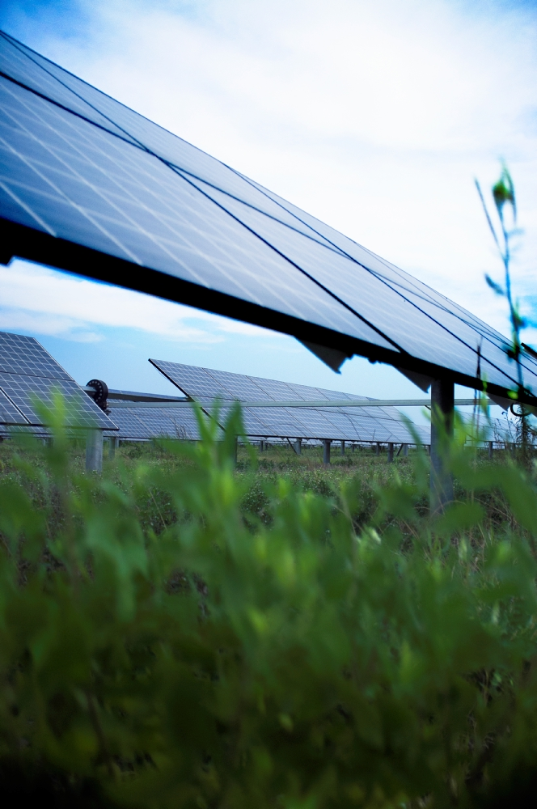
Duke Energy Renewables
More than 1,700 MW of wind and solar projects operating in nine states
Significant pipeline of development projects
Since 2007, invested more than $3 billion to grow wind and solar business

Slide 7
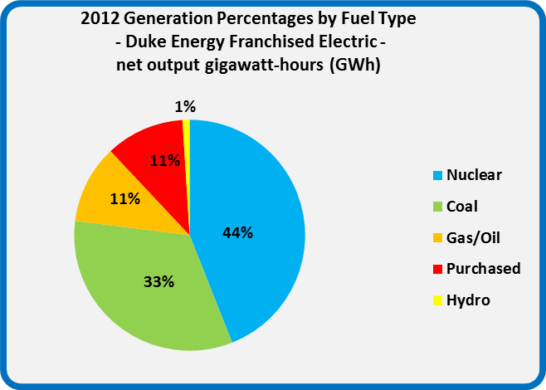
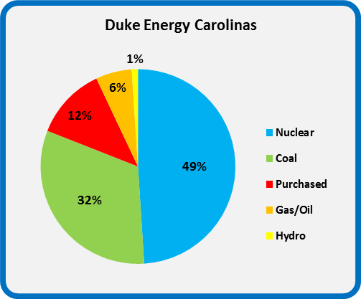
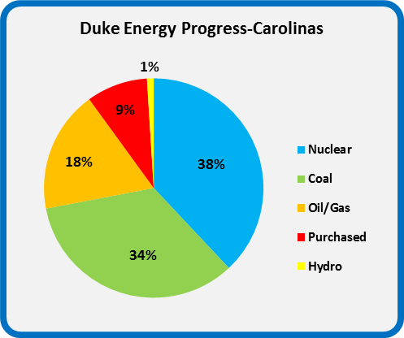
Duke Energy Generation Mix
As the largest electric utility in the country, Duke Energy’s generation portfolio incorporates a diverse fuel mix. We generate energy using fossil fuels, such as coal, natural gas and oil, as well as nuclear and renewable energy sources including water, wind, solar and biomass. Duke Energy makes life better for millions of people every day by providing electric and gas services in a sustainable way – affordable, reliable and clean.

Slide 8
Economic Development in the Carolinas

Slide 9
2013 Carolinas Overview
In 2013, our NC-SC Economic Development team continued their successful track record announcing 63 new and expanding projects - contributing over $1.3 BILLION in capital investment and creating over 6,700 jobs in the Carolinas!
Recognized once again by Site Selection magazine to their annual list of Top Utilities in Economic Development.
Introduced unique & innovative programs to expanded Company footprint to include:
Business Development Team - aggressive recruitment of 7 specific target industries which “move the needle” in jobs, capital investment & electrical revenues
Site Readiness Program – identifies, evaluates & prepares future sites for industrial development
Site Certification Program – certification of sites for specific industries

Slide 10
Some significant wins in 2013 for Enterprise Econ Dev teams
North Carolina
North Carolina
Indiana
Ohio
Indiana
North Carolina
Kentucky
Florida

Slide 11
2013 Eastern North Carolina Announcements

Slide 12
2013 high profile announcements for Eastern North Carolina
Wayne
Pender
New Hanover
Columbus
Harnett
Florida

Slide 13
Duke Energy Service Territory

Slide 14
Carolinas ED Territorial Assignments
Surry
Stokes
Rockingham
Person
Warren
Caswell
Granville
Vance
Halifax
Avery
Wilkes
Yadkin
Forsyth
Orange
Franklin
Mitchell
Guilford
Alamance
Durham
Madison
Yancey
Caldwell
Alexander
Davie
Nash
Edgecombe
Burke
Catawba
Iredell
Davidson
Randolph
Chatham
Wake
Wilson
Buncombe
McDowell
Rowan
Pitt
Beaufort
Swain
Haywood
Rutherford
Lincoln
Cabarrus
Lee
Johnson
Greene
Graham
Henderson
Montgomery
Harnett
Wayne
Jackson
Polk
Cleveland
Gaston
Stanly
Moore
Lenoir
Craven
Cherokee
Macon
Transylvania
Cherokee
Mecklenburg
Cumberland
Pamlico
Clay
York
Union (NC)
Richmond
Hoke
Sampson
Jones
Pickens
Spartanburg
Anson
Duplin
Oconee
Greenville
Lancaster
Scotland
Onslow
Carteret
Union (SC)
Chester
Chesterfield
Marlboro
Robeson
Bladen
Anderson
Laurens
Pender
Fairfield
Kershaw
Darlington
Dillon
New
Hanover
Abbeville
Newberry
Columbus
Greenwood
Lee
Florence
Marion
Brunswick
McCormick
Saluda
Sumter
Horry
Clarendon
Williamsburg
Georgetown
South Carolina Economic Development Team
North Carolina Economic Development Team
 | Steve West
 | Sandy Martin
 | Stuart Ames
 | John Geib (NC Director)
 | Tammy Whaley
 | Bill Roberts
 | John Nelms
R-June13

Slide 15
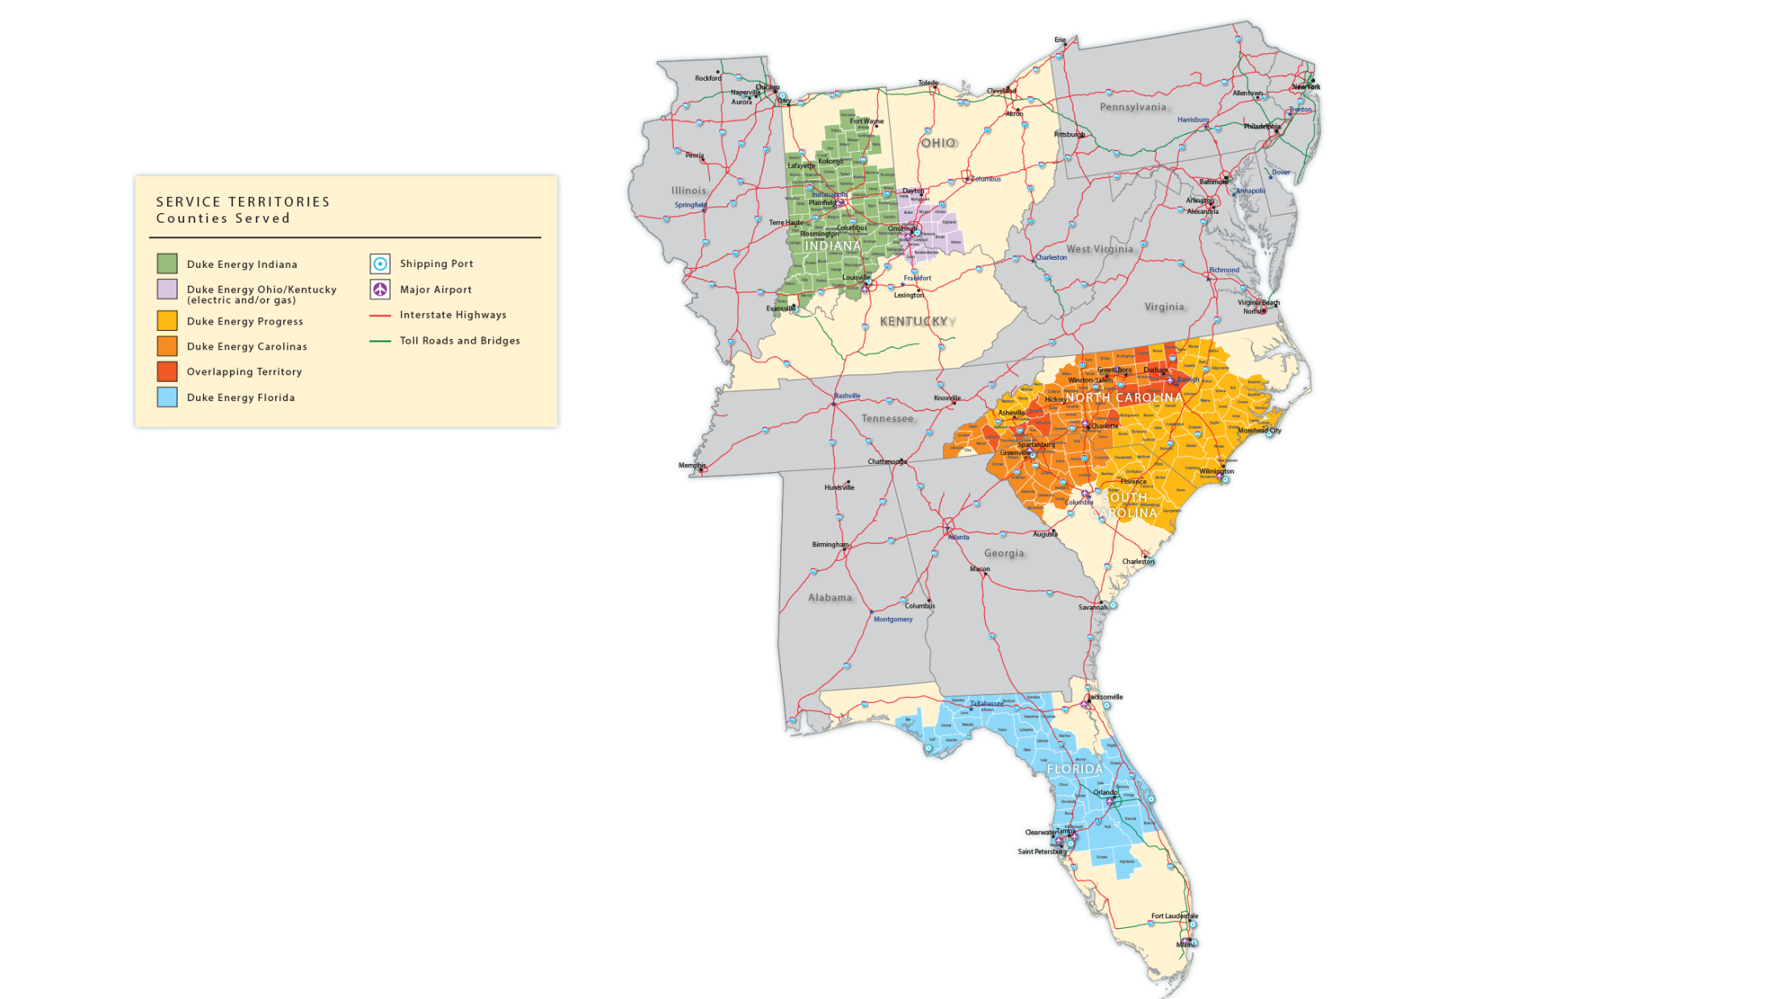
Full Service Territory

Slide 16
Site Readiness Program

Slide 17
Site Readiness ---- Overview
The Site Readiness Program is the cornerstone of Duke Energy’s economic development model. It identifies, evaluates, and improves industrial sites in the company’s service territory for potential industrial development.
Ideal properties for Duke Energy’s site readiness program are 75 acres or larger, served by the utility. A qualified site can be suited either for a single, large industrial facility, data center, or potential industrial park (multi-tenant site).
In 2013, sixteen (16) industrial sites were assessed in both Carolinas, including one mega-site evaluation.
13 of the total 16 sites were located in former Progress footprint in both Carolinas
6 in North Carolina
In 2014 we anticipate assessing an additional 8 sites (mostly in former Progress footprint). We will also be introducing Target Industry Certified Site Pilots.
to officially certify 3 large industrial sites (2 in NC, 1 in SC) as “Certified Food & Beverage Sites” -- verifying that they are fully ready to win large food & beverage processing or manufacturing facilities
to officially certify 3 large sites in SC as “Certified Data Center Sites” -- verifying that they are fully ready to win large data center projects.
County | Site Name | Site Size
Rutherford | Daniel Road Site | 90
Montgomery | Bisco Site | 220
Randolph | Heath Dairy Site | 200
Brunswick | Navassa Site | 220
Harnett | Mastin-Baker Site | 261
Nash | Middlesex Corporate Center | 322
Pender | Pender Commerce Park | 774
New Hanover | BASF Site | 700
Chatham | Chatham / Randolph Mega Site | 1625

Slide 18
Site Readiness ---- Overview
10 Projects WON (thus far) on Site Readiness Sites
North Carolina:
AmEx Data Center, Guilford County
Apple Data Center, Catawba County
Clearwater Paper, Cleveland County
Hydac, Lincoln County
Sheetz Distribution Center, Alamance County
Sierra Nevada Brewing, Henderson County
South Carolina
American Titanium Works, Laurens County
Haille Metals Lab, Lancaster County
Lear, Inc, Spartanburg County
Perma-Shrink, York County
Outokumpu Stainless Bar, Chester County
Duke Energy Site Readiness Program Summary
The program includes:
Initial assessment of industrial sites (existing or potential) from the perspective of a top site selection consultant, McCallum Sweeney Consulting.
A more detailed “buildable area” assessment and development of conceptual plans for the site(s) by expert land use / site planners.
For each site the studies validate as viable for large industry, Duke Energy will provide a $10,000 matching grant for implementing improvements recommended by the studies.

Slide 19
Our Business Development Team

Slide 20
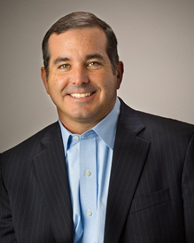
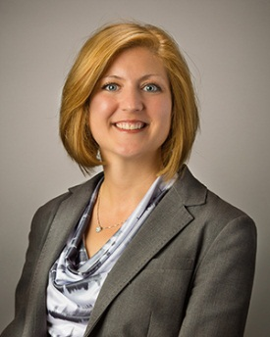
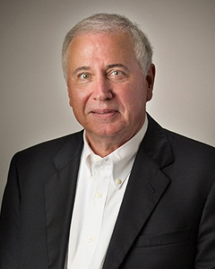
Our Team
Alan Jones
Director, Business Development
Life Sciences and Food/Beverage
Kristie McKillip
Business Development Manager
Aerospace and Industrial Manufacturing
Ronald Davis
Business Development Manager
Automotive and Chemicals
John Fremstad
Business Development Manager
Data Centers

Slide 21
Who We Support
Mission: to provide site selection services and electrical rate data to companies and allies considering locating in our electric service territory (NC, SC, FL,IN, OH, KY)
We Support:
Industrial users of energy
Site consultants
Real estate service providers
A&E firms
Law firms
Services:
Confidentiality
Site identification
Building identification
Electric rate quote
Incentives summary
Host client visit
All services are gratis and confidential

Slide 22
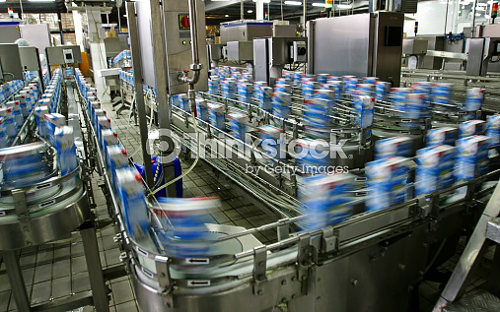
Business Target Sectors
Data Centers
Industrial Mfg
Automotive
Life Science/R&D
Chemicals
Food/Beverage Mfg.
Aerospace

